Slide 1
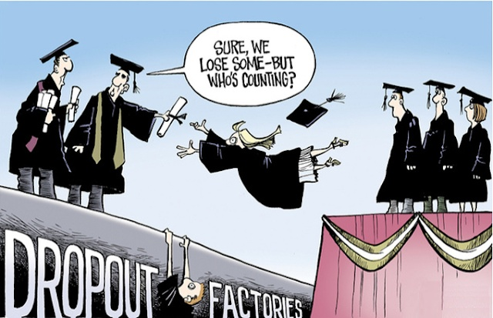
CAPSTONE PROJECT WITH PYTHON
Students’ Early Attrition Modelling for Clearwater State University
AnantaSunitaPatnaik

Slide 2
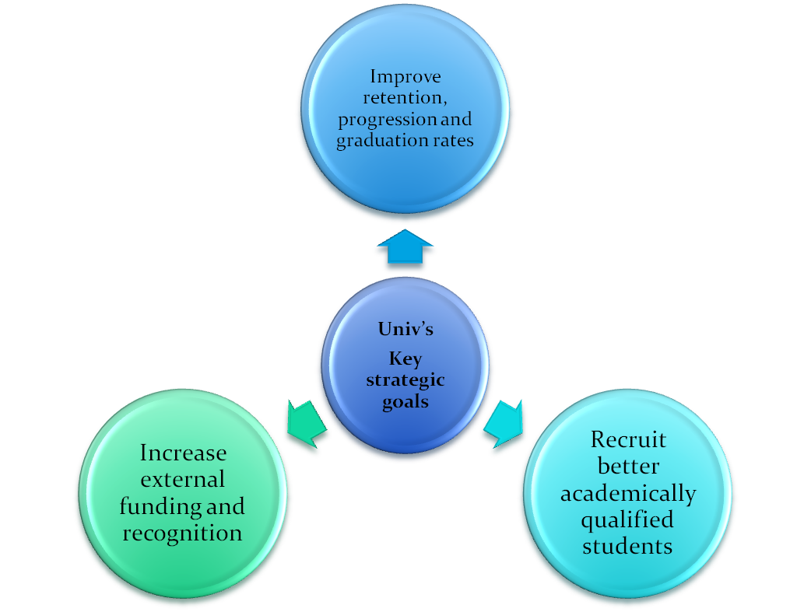
Clearwater State University offers a wide variety of degree programs – Classroom sessions, online degrees to doctorate in education.
Various Programs are offered in the streams of the arts, education, business & nursing

Slide 3

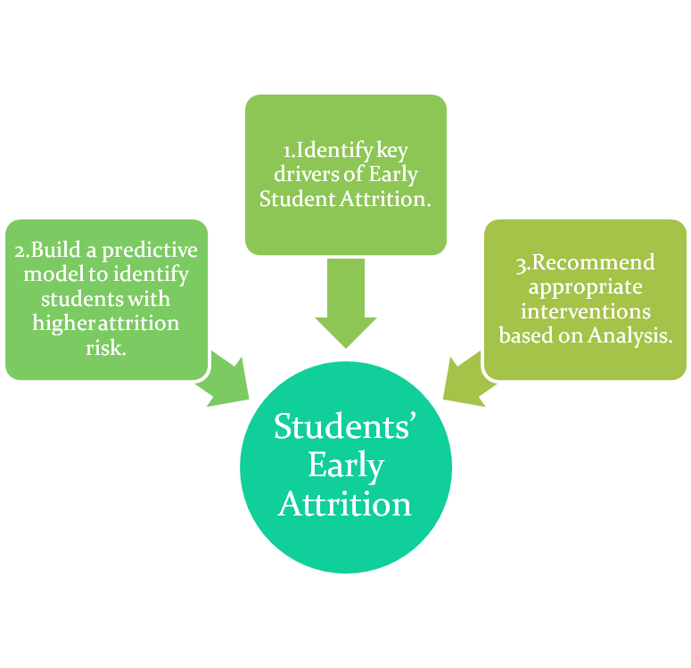
Clearwater State University has collected student data to check the enrollment to the curriculum programs and the percentage students continuing to the next year
It was observed that many students are opting out from continuing the next year.
The rate of attrition was around 23 - 25%.
An exercise was done to collect data from all enrolled students and the reasons why they did not continue their studies
Data analysis and visualization techniques are used to arrive the root cause of attrition and develop a strategic retention plan

Slide 4

.
Reading and checking size of data.
Descriptive Statistics:
Basic measures of central tendency were used to validate if correct data is being used for modelling.
Missing Value treatment: Imputing Missing Values with mean for numeric and mode for categorical values.
Correlation:Checking the correlation between the variables for further predictive analysis.

Slide 5

Response Variable Coding:
Converting ‘RETURNED_2ND_YR’ variable to 0 and 1 accordingly as python will model for event 1.
Outlier Detection:To ensure we don’t have highly skewed values.
  Student Age and Distance from home are highly skewed
  Normalising the data to mitigate the effect of Outliers.

Slide 6
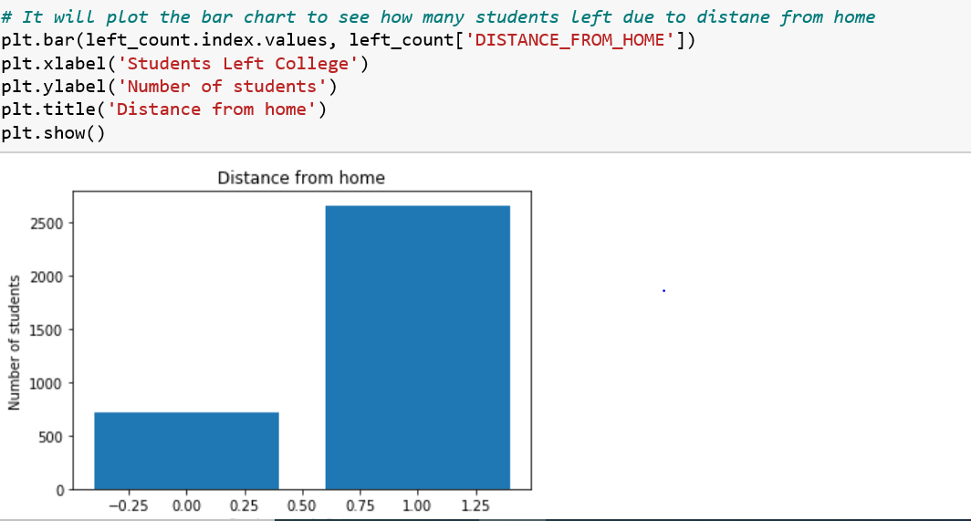
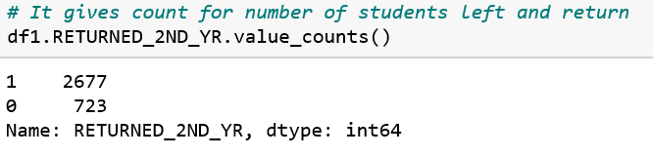
Data Visualization:
Here we can see that Out of 3400 students, 723 left the college and 2677 were returned back to 2nd year.
Total 21.26% students left the college

Slide 7
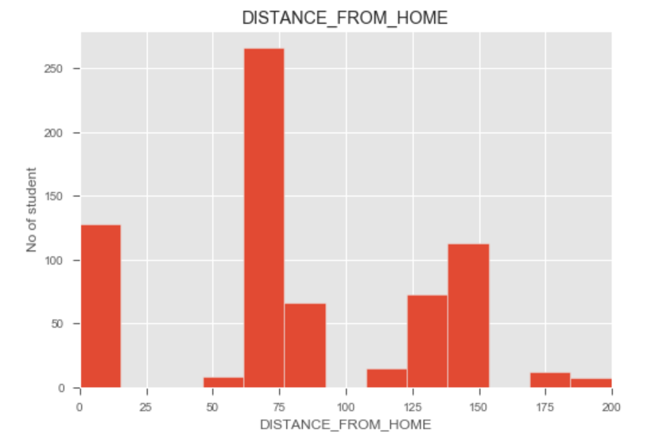
Data Visualization by plotting Histogram:Distance from Home
We can infer from the graph that Students who left the college are 60 to 80 kms away from college.
Overall 48% students have left because of far distance from home.
Distance from home distribution is positively skewed.

Slide 8

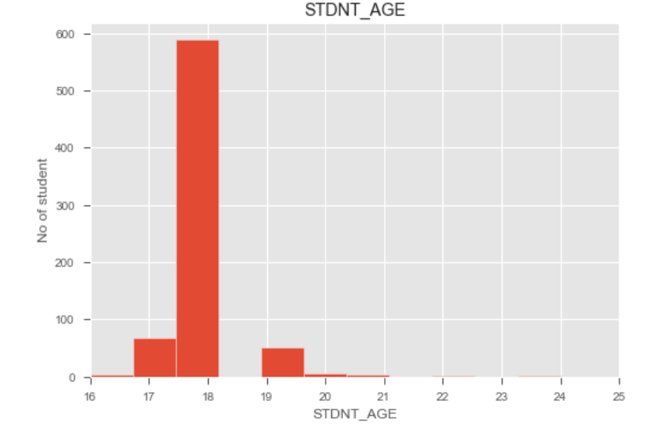
Age distribution is a slightly right-skewed distribution.
Bulk of the students who left are 18 years old.

Slide 9

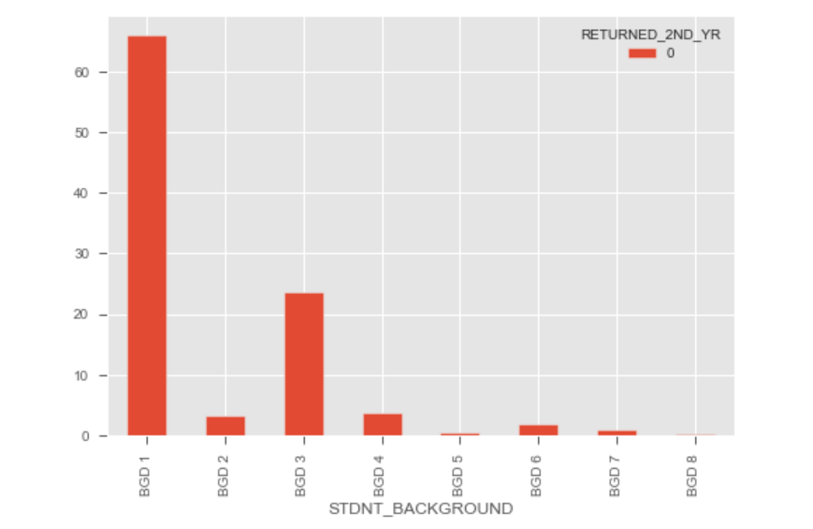
Majority of students who left college are from BGD1 followed by BGD3.

Slide 10
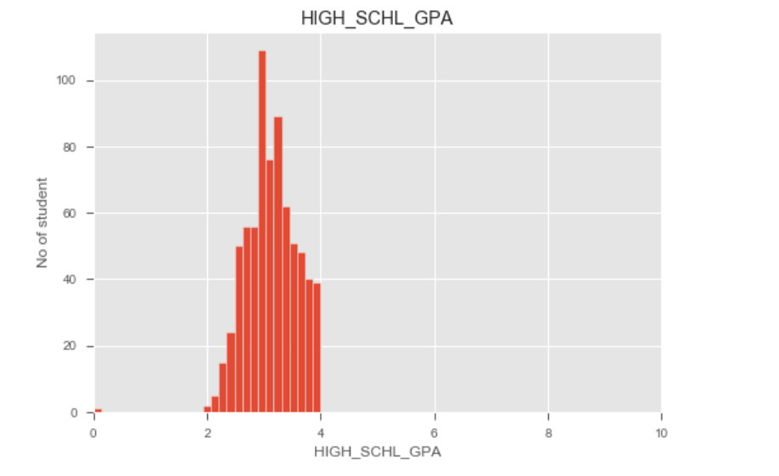
Majority of students who left college have High School GPA ranging between 2 to 4.

Slide 11

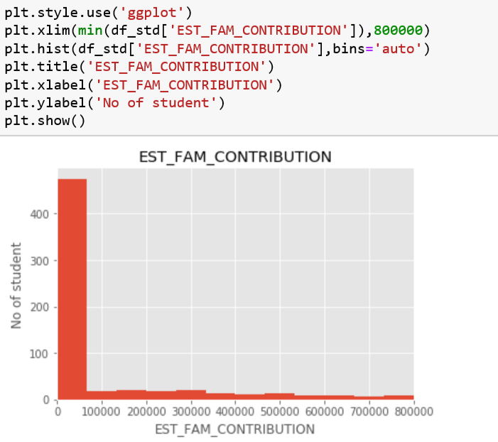
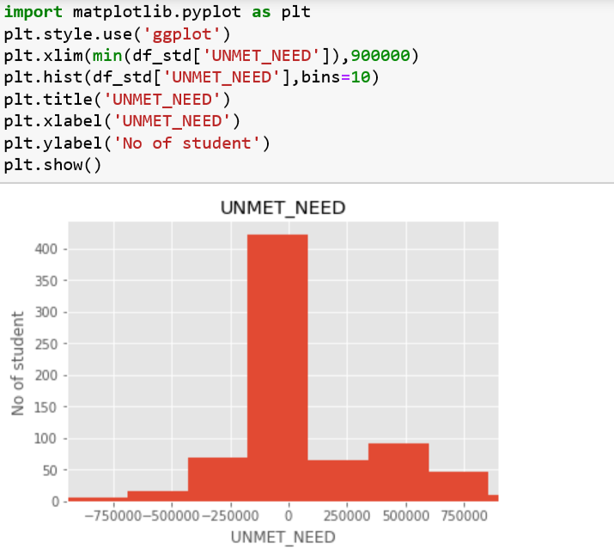
Students whose needs were not met those students left percentage is 48%.
Students whose family contribution is less than 1 lakh –Left % is 66%
Unmet needs and Estimated Family Contribution are showing Negative Correlation.

Slide 12

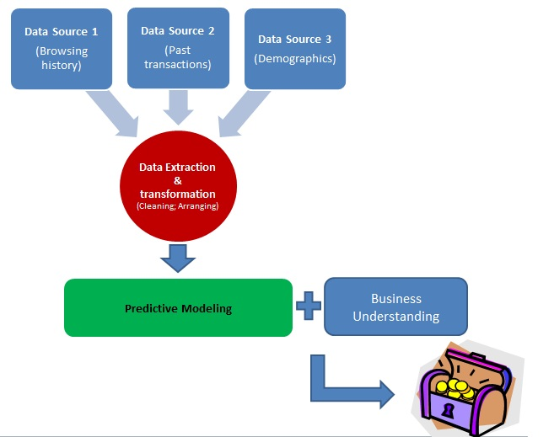
Here we have Built a predictive model to identify students with higher Early Attrition Risk.

Slide 13
The data we use is usually split into training data and test data. The training set contains a known output and the model learns on this data in order to be generalized to other data later on. We have the test dataset (or subset) in order to test our model's prediction on this subset . Train/test is used to measure the accuracy of model

Slide 14
Building Machine Learning Models
The algorithms considered in this section are:
Logistic Regression,
Random Forest,
Decision Tree Classifier,
XGboost

Slide 15
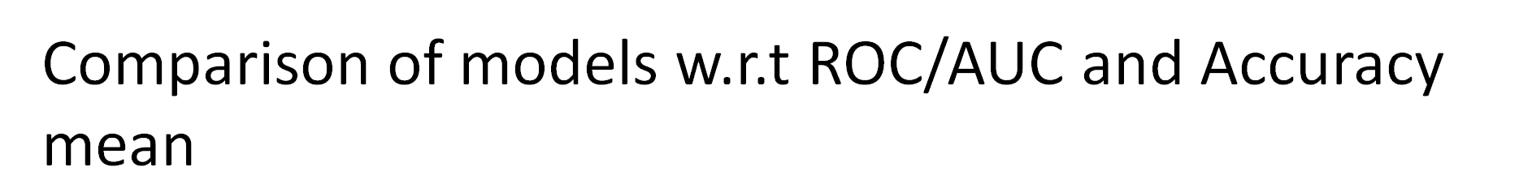
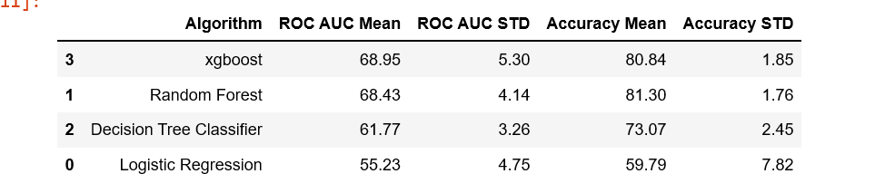
Classification Accuracy is the number of correct predictions made as a ratio of all predictions made. It is the most common evaluation metric for classification problems.
From above table- XG Boost and Random forest are best model for further prediction analysis

Slide 16

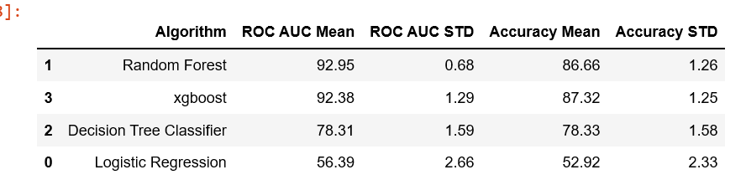
SMOTE (synthetic minority oversampling technique) is one of the most commonly used oversampling methods to solve the imbalance problem.
SMOTE synthesises new minority instances between existing minority instances. It generates the virtual training records by linear interpolation for the minority class.

Slide 17
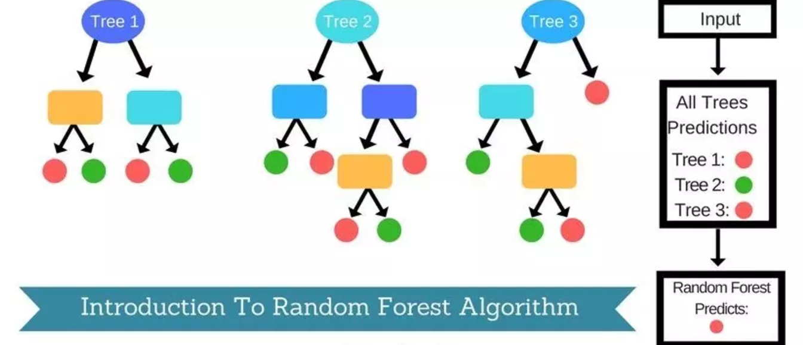
Random Forest
Random Forest is a popular and versatile machine learning method that is capable of solving both regression and classification.
Random Forest is a brand of Ensemble learning, as it relies on an ensemble of decision trees. It aggregates Classification (or Regression) Trees.
A decision tree is composed of a series of decisions that can be used to classify an observation in a dataset.
Random Forest fits a number of decision tree classifiers on various sub-samples of the dataset and use averaging to improve the predictive accuracy and control over-fitting.
Random Forest can handle a large number of features, and is helpful for estimating which of your variables are important in the underlying data being modeled.

Slide 18
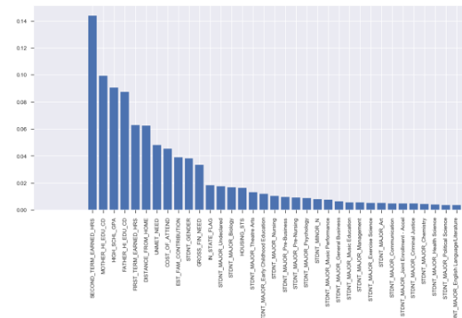
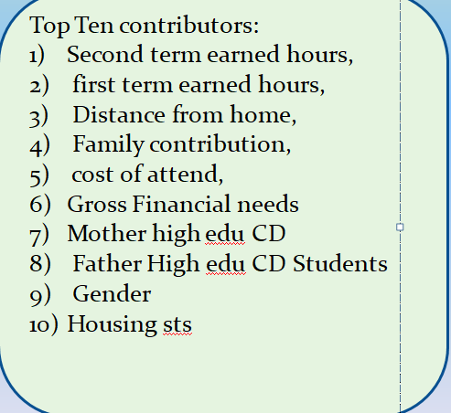

Slide 19
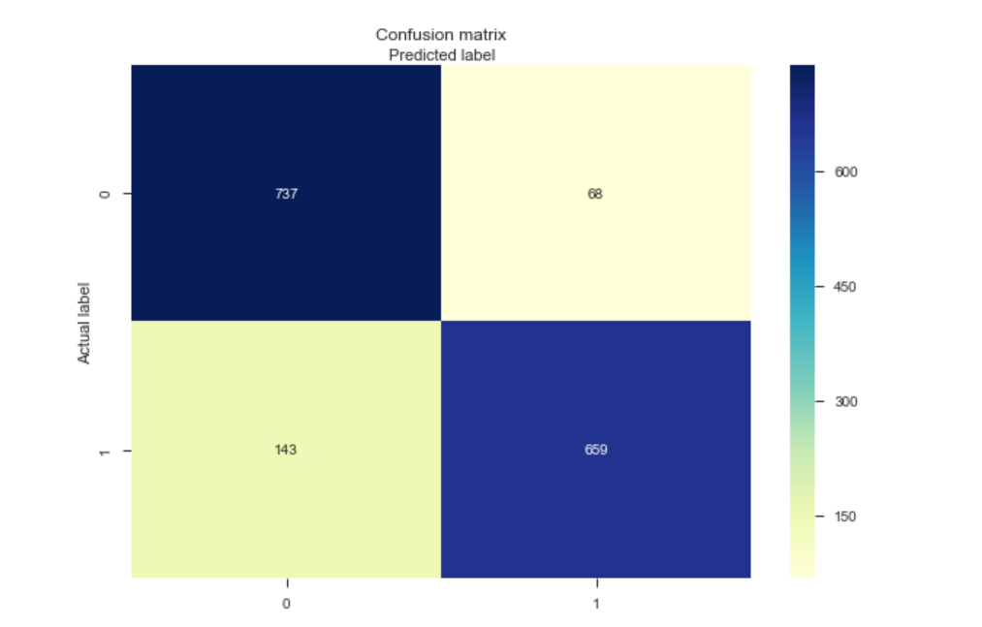
Confusion Matrix
Confusion Matrix: A confusion matrix is a performance measurement for machine learning classification problem where output can be two or more classes. It is a table with 4 different vales of Actual and predicted Values.
Classification Rate/Accuracy: Accuracy = (TP + TN) / (TP + TN + FP + FN) = (669+ 737) /(669+ 737 + 68 + 143) = 0.869
Recall: Out of all the positive classes,how much we predicted correctly.It should be high as possible Recall = TP / (TP + FN) = 669 / (669 + 143) =0.82
Precision: Out of all the positive classes we have predicted correctly, how many are actually positive.. Precision = TP / (TP + FP)=669/ (669+68) = 0.90
F-measure: Fmeasure = (2 * Recall * Precision) / (Recall + Precision) = 2 *( 0.82 * 0.90) / (0.82 + 0.90) = 0.86

Slide 20
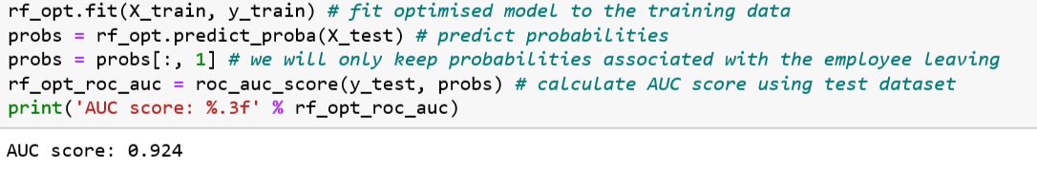
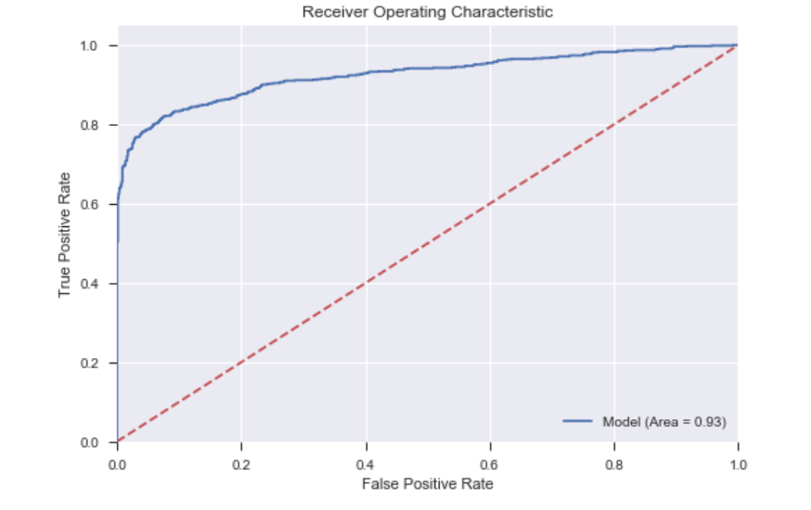
RANDOM FOREST—AUC SCORE

Slide 21
XG Boost -
XGBoost is an implementation of gradient boosted decision trees designed for speed and performance that is dominative competitive machine learning.
The two reasons to use XGBoost are also the two goals of the project: Execution Speed. Model Performance.
XGBoost Execution Speed Generally, XGBoost is fast. Really fast when compared to other implementations of gradient boosting.
XGBoost Model Performance XGBoost dominates structured or tabular datasets on classification and regression predictive modeling problems.

Slide 22
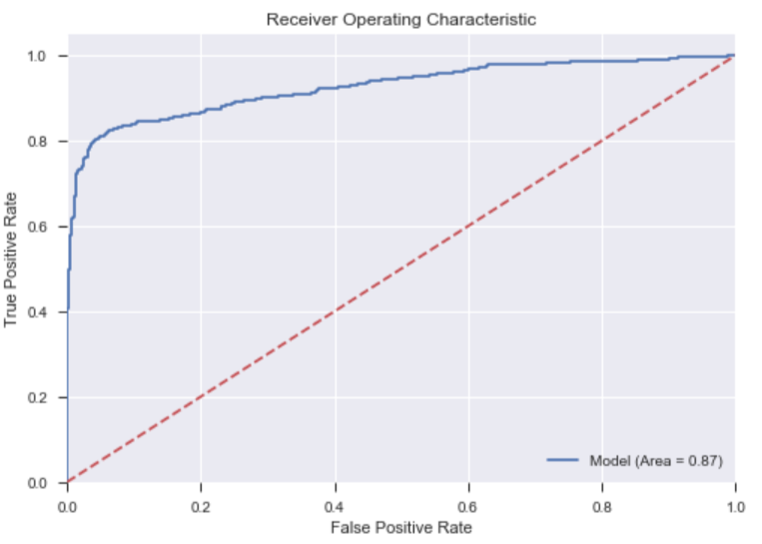
XG Boost- ROC/AUC score
AREA UNDER THE ROC CURVE AUC is an effective way to summarize the overall diagnostic accuracy of the test.
It takes values from 0 to 1, where a value of 0 indicates a perfectly inaccurate test and a value of 1 reflects a perfectly accurate test. AUC can be computed using the trapezoidal rule.3

Slide 23
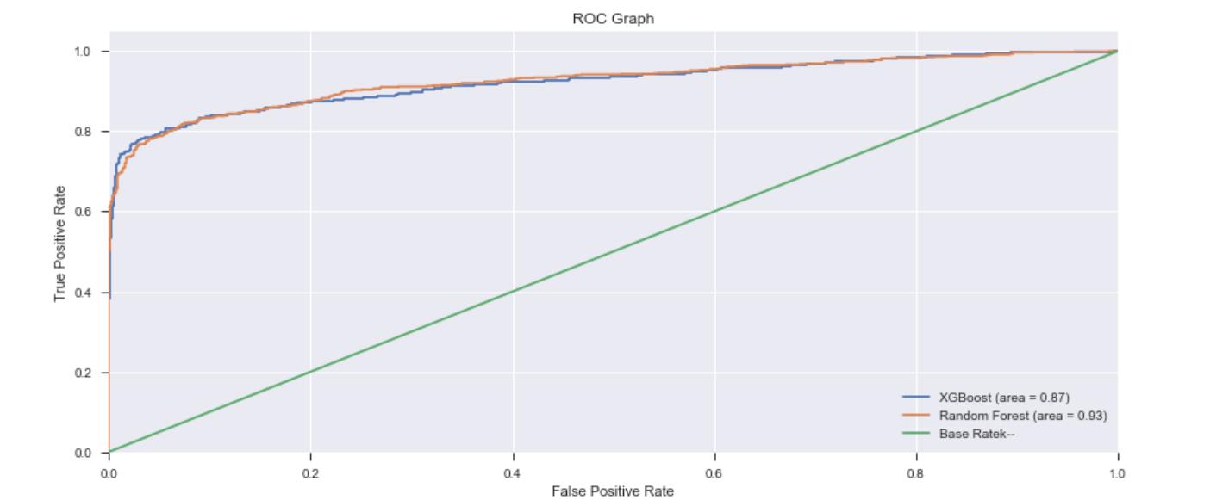

Multimodel –comparison of AUC scores

Slide 24
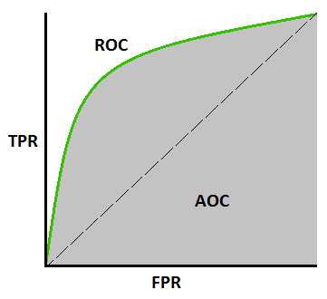
TPR, FPR definitions:
A useful tool when predicting the probability of a binary outcome is the Receiver Operating Characteristic curve, or ROC curve.
It is a plot of the false positive rate (x-axis) versus the true positive rate (y-axis) for a number of different candidate threshold values between 0.0 and 1.0. Put another way, it plots the false alarm rate versus the hit rate.

Slide 25
Conclusion Remarks:
Case Study: Clearwater State University offers a wide variety of degree programs, from online degrees to a doctorate in education. Programs are offered in the streams of the arts, education, business & nursing
Objective of Project: To Leverage data on student demographic profile, course preferences, performance record, grades, financial background, financial aid and other application information to:
1. Identify key drivers of early student attrition
2. Build a predictive model to identify students with higher early attrition risk
3. Recommend appropriate interventions based on the analysis
Remarks:--
Following are key drivers identified from analysis which are potential cause of student attritions.
Second term earned hours,
first term earned hours,
Distance from home,
Family contribution,
cost of attend,
Second term earned hours -

Slide 26
Conclusion & Recommendation:
1)Second term earned hours –a) From the data we observed that students who have more earned hours in second term are Returning to second year and viceversa. Approx 25% students have low second term earned and attempt hours. So these students left.
There is high positive correlation between second term attempt and earned hours.
About 24% of students have also scored less grades in first term.. Found this course is not correct fit for them…Hence drop out.
Recommendation: As a data analyst following are the possible recommendation :-
Those students who score less score/grade in first term—need to work on those students..they might feel that this course is very tough or not suitable for them.
If we provide some extra class then it will help then to boost their moral and inspire them to study more to achieve grades.
Term wise feedback session to be planned so that there will interaction between student –teacher

Slide 27
Conclusion & Recommendation:
2)First term earned hours – From the data we observed that students who left college scored very less Earned Hours. Approx 23% students score less Earned Hours. Found this course is not correct fit for them so they left.
Recommendation: On the basis of following are the possible recommendation :-
Those students who score less score/grade in first term—need to work on those students..they might feel that this course is very tough or not suitable for them.
If we provide some extra class then it will help then to boost their moral and inspire them to study more to achieve grades.
Term wise feedback session to be planned so that there will interaction between student –teacher
3) Distance from home- Data shows that 21% Students who left the college area having average distance from there home is more than average distance who continued in second year in college
Average distance of these students are 112km.
Also it is found that out of 713 students who left college – 53% students are staying off campus
Recommendation:
Students who are not staying in campus- first thing to provide them hostel with less fees
We can provide them bus facility in and around of 150km range

Slide 28
Conclusion & Recommendation:
4)Family contribution – Data shows that 456 students left due to one of reason of family contribution.
Out of 456.. There are 41% i.e 187 students who not get any support from family or society for fees.
Recommendation: On the basis of following are the possible recommendation :-
Identify potential students who are brilliant in studies –and offer them scholarship
Provide Education loan facility
Earn and learn scheme –so that they can also support to their families
3) GENDER- Based on the data.. It is observed that 66% ..i.e 457-female students left the college.
Recommendation-
Empower women power by boosting their moral.
Scholarship for female students
Provide-Safety environment ---feel good factor –to attend the college
Job opportunities
Implementation of POSH

Slide 29

THANKS!

